Slide 1

Object Orientated Software Engineering
3.2 Class Diagrams, Encapsulation, and Abstraction
By Stephen Lindsay

Slide 2
Outline
Inheritance
Polymorphism
Abstraction of Inheritance in Java?

Slide 3
Principle 3: Inheritance
Inheritance is the ability for objects to inherit variable and functional behaviour from a parent object. This allows for substantial code re-use.
The benefits of inheritance are
Code re-use so we have to write less code
Extensibility – can extend class logic as needed
Hiding data – we can keep data private (encapsulation again)

Slide 4
Inheritance in Java
public class PowerTool
{
private boolean batteryPowered;
private Date lastElectricalTest;
private int operatingLifetime;
// check safe to use, renew lastElectricalTest
public void serviceTool()
// check if power tool needs to be serviced
public boolean needsService()

Slide 5
Inheritance in Java
public class PowerDrill extends PowerTool
{
private String bitType;
private int torque;
private int run(int hours)
{
// increment operating lifetime
// reduce battery life if needed
// if drilling, run breakageCheck()
// return work done over this time
}
}

Slide 6
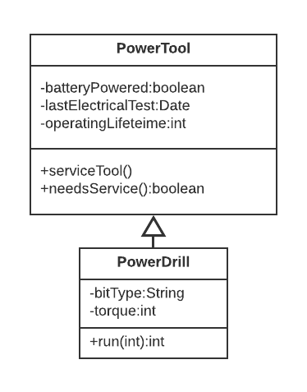
UML of Inheritance
UML and Inheritance

Slide 7
Multi-Level Inheritance in Java
Hierarchical inheritance in Java:
public class Jigsaw extends PowerTool
public class Drill extends PowerTool
public class CircularSaw extends PowerTool
Allows us to code base methods in one place and maintain code there
Multi-level inheritance in Java:
public class ImpactDriver extends PowerTool
Build up layers of specialist functionality

Slide 8
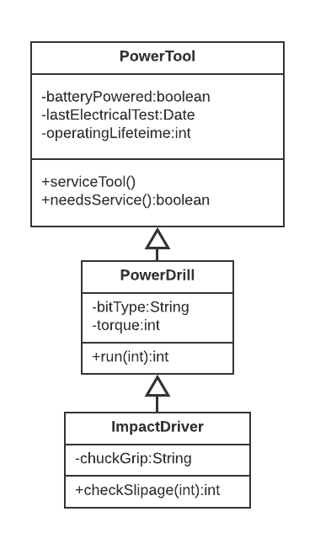
UML of Inheritance
Multi-Level
Inheritance

Slide 9
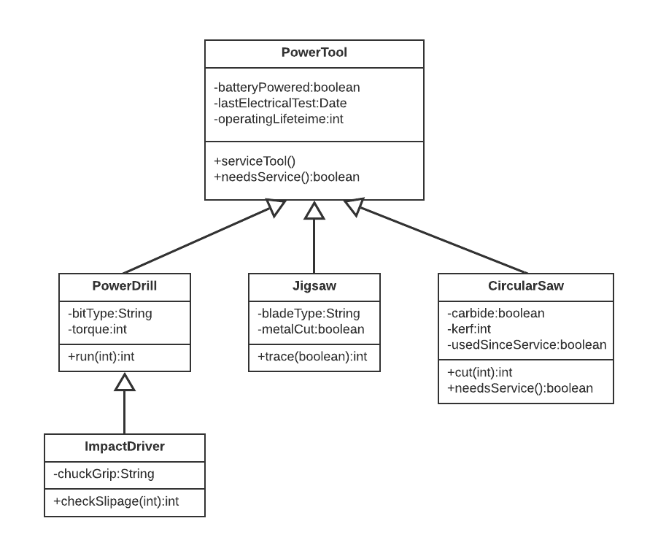
UML of Inheritance
Hierarchical
Inheritance

Slide 10
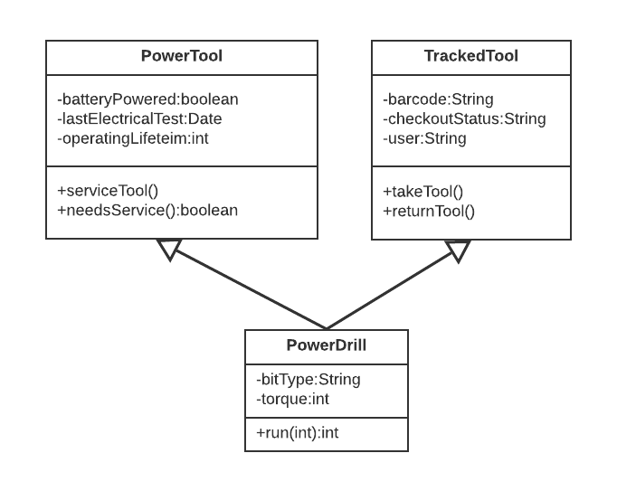
UML of Inheritance
Multiple
Inheritance

Slide 11
UML of Inheritance
Multiple
Inheritance
Not possible in Java

Slide 12
Abstract keyword
You hopefully noticed that the base PowerTool in the previous class was not an Abstract class
The same is true of CardGame in the lab sessions which BlackJack extends
Abstract classes are ones that can not be instantiated, they let you design a super class which should not ever be able to exist without more information
Abstract classes can still hold concrete implementations of some of their methods
Abstract methods in Java are similar but work for methods, they make a namespace for the method that can’t be called without causing an error until a sub-class implements the method

Slide 13
Abstract classes in Java
public abstract class PowerTool
{
// same code as before
}
Trying this will get an error because we cannot instantiate abstract classes:
PowerTool pt = new PowerTool();
Instead we must instantiate the class like this:
PowerTool pt = new Drill();

Slide 14
Abstract classes in Java
More commonly we see the abstract class used like this to allow us to work on lists of a similar type of item:
ArrayList<PowerTool> companyTools = new
ArrayList<PowerTool>;
tools.add(new Drill());
tools.add(new CircularSaw());
tools.add(new ImpactDriver());
We can do lot’s of useful things with this list, like loops through it and find all the power tools that need to be serviced by calling PowerTools needsService()

Slide 15
Principle 4: Polymorphism
The ability for the same function name to do different things depending on the context it is used in.
Polymorphism is strongly linked in to the concept of inheritance as the most common time to need to use it is to override the method implemented in a superclass
Polymorphism is the most specific of the OO principles
It’s also the most critiques as well, not all developers think that it is important/necessary/useful to reuse the same names a lot

Slide 16
Reminder – Power Tool
public class PowerTool
{
private boolean batteryPowered;
private Date lastElectricalTest;
private int operatingLifetime;
// check safe to use, renew lastElectricalTest
private void serviceTool()
// check if power tool needs to be serviced
private boolean needsService()
// check if the tool breaks in use, return breakage details
private String breakageCheck()

Slide 17
Polymorphism in Java - Overriding
PowerTool implements a needsService() method but perhaps CircularSaws are particularly dangerous and need to be serviced after every time they are used
public class CircularSaw extends PowerTool{
boolean usedSinceService;
// in CircularSaw, just returns usedSinceService
private boolean needsService()
// check safe to use, reset usedSinceService boolean
private void serviceTool()

Slide 18
Polymorphism in Java - Overriding
This code will work just fine because java allows us to override a method
Overriding is when a subclass replaces a method with it’s own code
Method calls of the class will use the new behaviour by default
You can still access the super classes method with the super keyword, for example, calling super.needsService() in the CircularSaw class will get a result based on the date last serviced from tool

Slide 19
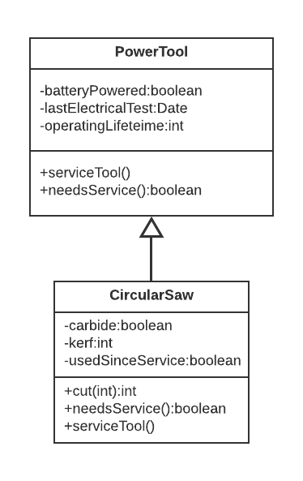
UML of Inheritance
Overriding Methods

Slide 20
Polymorphism in Java - Overloading
A similar concept to overriding is that of overloading, this is when multiple methods in the same class share the same name but have different input parameters
public class PowerTool
{
…
// check safe to use, set lastElectricalTest to
// todays date
public void serviceTool()
// sets lastElectrical to be dateOfService
public void serviceTool(Date dateOfService)

Slide 21
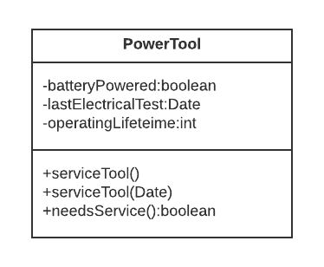
UML of Inheritance
Overloading Methods

Slide 22
Inheritance or Interfaces?
It probably hasn’t escaped your notice that Abstraction and Inheritance seem quite similar
Java naming can add to this confusion, it is a bit unhelpful when learning OOP concepts because:
Full Abstraction is realised by using the interface/implements keywords
Inheritance is realised with the abstract/extends keywords but this only realises partial Abstraction!
With all this fuss, you might be wondering why we bother to use one or the other

Slide 23
Inheritance or Interface in Java?
Inheritance
Allows for code-reuse as subclasses get the code of the superclass
Can have abstracted elements with the abstract keyword
But can only allow inheritance from 1 class
Interfaces
Create blueprints to guide program development with no details of implementation needed at all
Can allow multiple blueprints to be implemented in a single class
But does not share any code

Slide 24
Why we use Abstraction
Imagine you are building a video game and you need some game world objects to:
Know if they collide with other objects (collidable)
Be affected by physics (physical)
Be aware of players around them and react to them (awareable)
Pathfind and move through the environment (pathable)
Take damage (hitable)
Deal damage (fightable)

Slide 25
Why we use Abstraction
public class Rock implements collidable
public class Cart implements collidable, physical, hitable
public class Child implements awareable, pathable
public class Pedestrian implements awareable, pathable, hitable, fightable
public class Guard implements collidable, physical, awareable, pathable, hitable, fightable
Notes:
How would this look if we tried to do it with inheritance?

Slide 26
Outline
Inheritance – allows a subclass to reuse code from a superclass – good code-reuse but tied into a 1-1 relaitonship
Polymorphism – allows us to use code with the same name in the same place – the least significant of the principles and simplest
Abstraction or Inheritance – beware abstract keywords and full abstraction, understand why we like to use abstraction even though it doesn’t get us to the point of code re-use

